Slide 1


Commercial Lines
Commercial
General
Liability
Property
Business
Owners
Program
Commercial
Auto
Commercial
Umbrella
Workers
Compensation
1

Slide 2
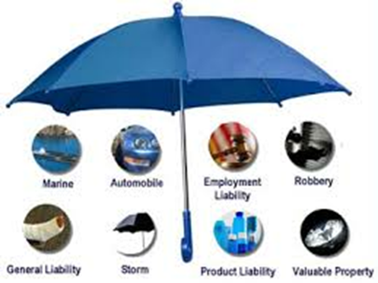
Commercial Umbrella
Liability

Slide 3
What is LIABILITY INSURANCE? : https://youtu.be/hQuo8kZ5Yms
Commercial General Liability Insurance Definition : https://youtu.be/GsPye8vG-Io
What Is Commercial General Liability Insurance: https://youtu.be/wQ8Eq3FMWGk

Slide 4

Commercial Lines
Umbrella Liability
Liability: Insurer agrees to pay on behalf of the insured sums he or she is legally obliged to pay as damages. As Auto Liability, General Liability, Advertising liability, Personal Liability etc.
Umbrella Liability:
is defined as something which provides protection over a broad range of elements or factors like supplemental protection for catastrophic losses and other losses which would not otherwise be covered by the underlying insurance policies
4
Notes:
Umbrella Policy- An umbrella policy is basically an additional policy that kicks in when your other insurance policies have reached their limits. The amount of coverage and types of coverage offered by these policies varies, as will their premiums.

Slide 5
Two Main Functions
1. Excess Coverage : for losses which are covered by primary or underlying liability policies
2. Self Insured Retention Limit : for losses that are not typically covered by the underlying liability policies

Slide 6
Offers two major coverages
1. Coverage A – Bodily Injury and Property Damage Liability
2. Coverage B – Personal and Advertising Injury Limits

Slide 7
Insurance 101 - Personal Umbrella Policy- https://youtu.be/FMRfWyorCFE
Personal Umbrella Insurance: A Simple Explanation- https://youtu.be/UZH__JQ5IqQ
The Benefits of Umbrella Insurance : https://youtu.be/_qd4K3HKHPw
Commercial Umbrella Coverage : https://youtu.be/n-pXlG-Kbfo

